Slide 1
SFBU Customer Support System - Speech to Text to Speech
Jubaida Tasnim

Slide 2
Table of Contents
Introduction
Design
Identifying Problems
Investigating Solutions
Comparing Solutions
Implementation
Features and Workflow
Testing
Screenshot of execution results
Enhancement Ideas
Conclusion

Slide 3
Introduction
Overview:
Brief description of the SFBU Customer Support System project.
Importance of real-time AI-driven interaction for enhanced customer support.
Goals:
Integrating speech-to-text, text-to-speech, and real-time question-answering functionalities.

Slide 4
Design
Why This Approach?
Identify and understand problems:
Traditional support systems lack real-time interaction.
Investigate possible solutions:
Explore speech-to-text, embedding-based retrieval, and conversational AI.
Compare solutions:
Selected OpenAI Whisper, LangChain, and gTTS for their robustness and scalability.

Slide 5
Implementation
Features Implemented:
Speech-to-Text Conversion:
Utilized OpenAI Whisper for high-accuracy transcription.
Document Loading and Retrieval:
Extracted and embedded documents using PyPDFLoader and OpenAI Embeddings.
Built a Conversational Retrieval Chain with LangChain.
Real-Time Interaction:
Designed a conversational dashboard using Panel.
Text-to-Speech:
Generated speech responses using OpenAI's TTS API.

Slide 6
Workflow
Diagram: Show the provided workflow graphic with:
Document Loading
Splitting into Chunks
Vector Database Storage
Retrieval and Question Processing
Text-to-Speech Output

Slide 7
Testing
Testing Process:
Verified accurate transcription of input queries.
Checked retrieval accuracy for different documents.
Validated seamless text-to-speech conversion.

Slide 8
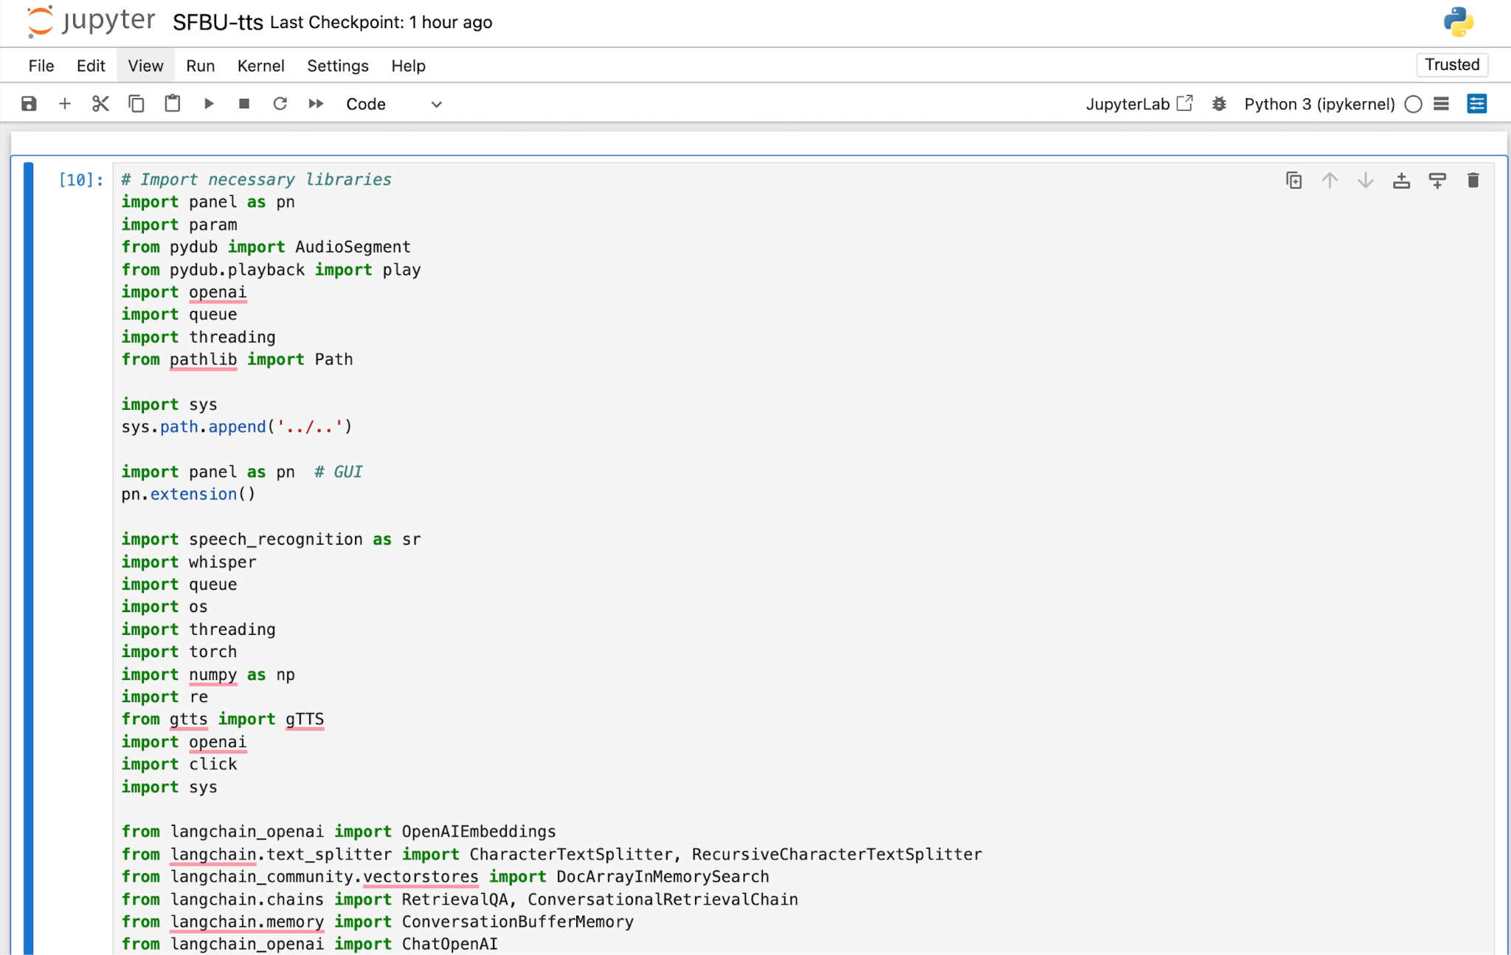
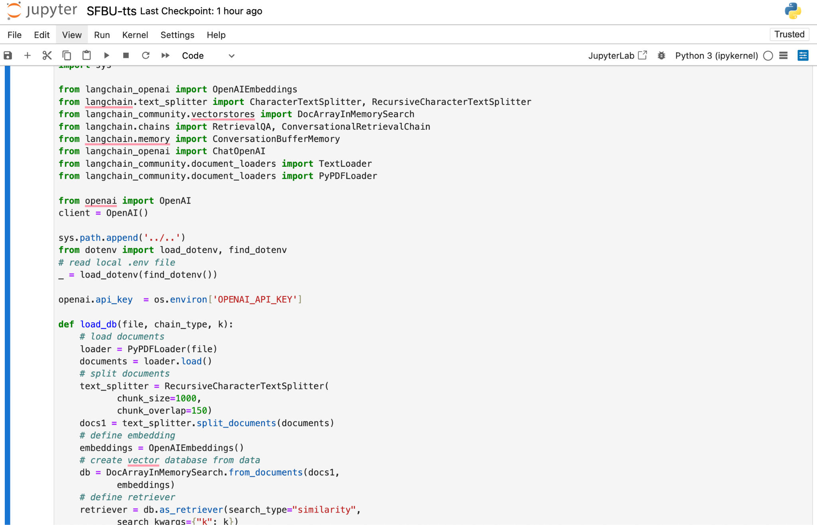
Screenshot of execution results

Slide 9
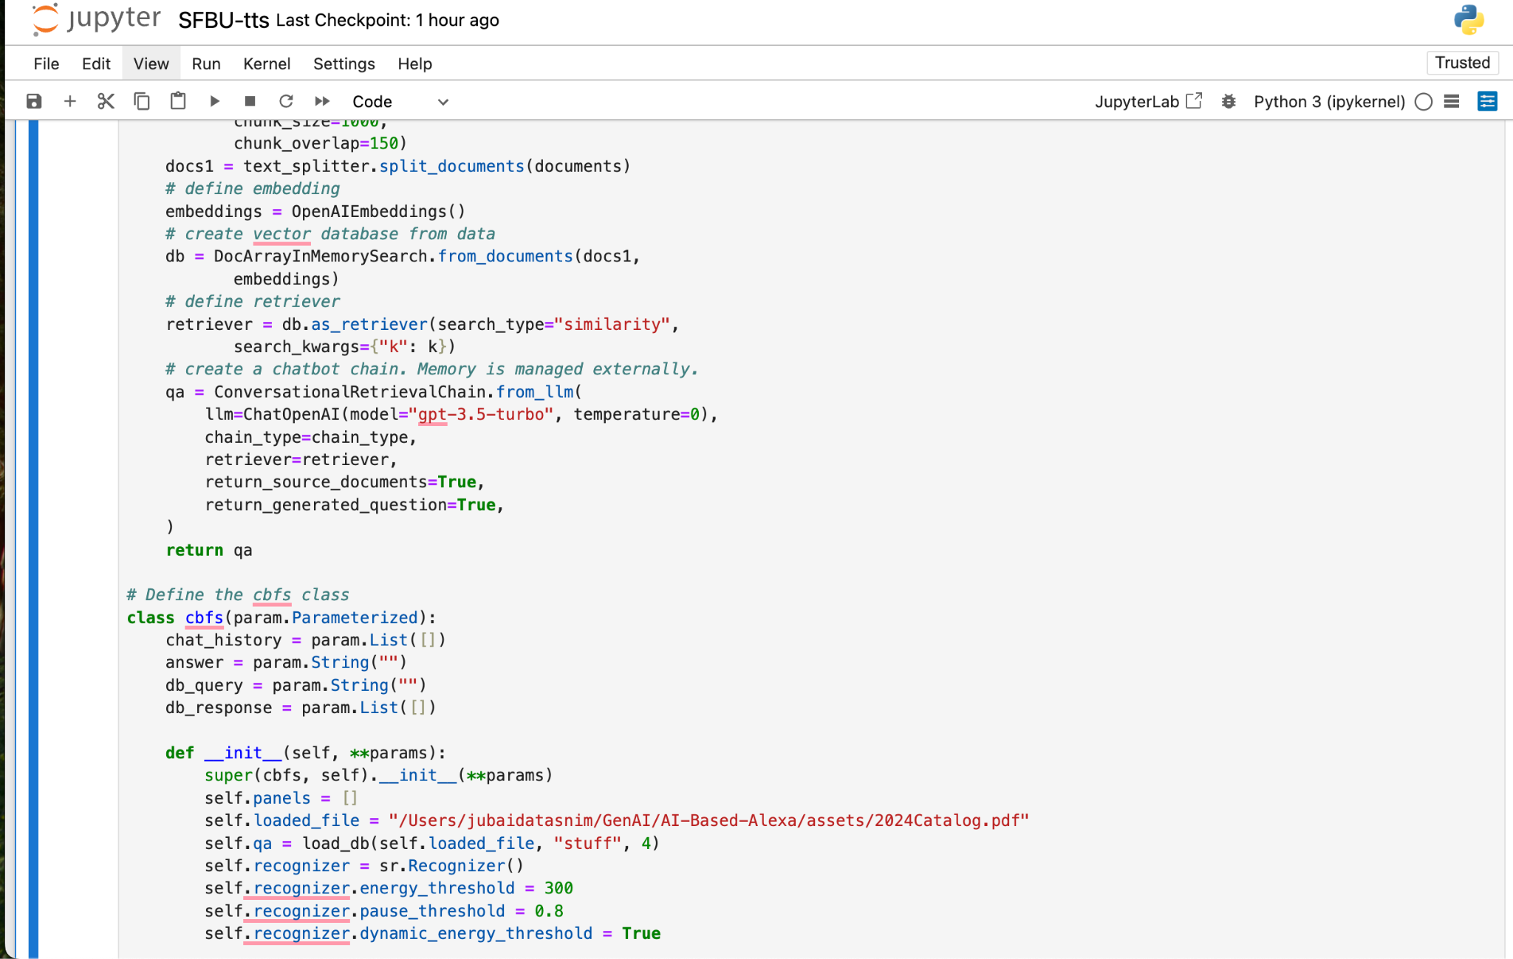
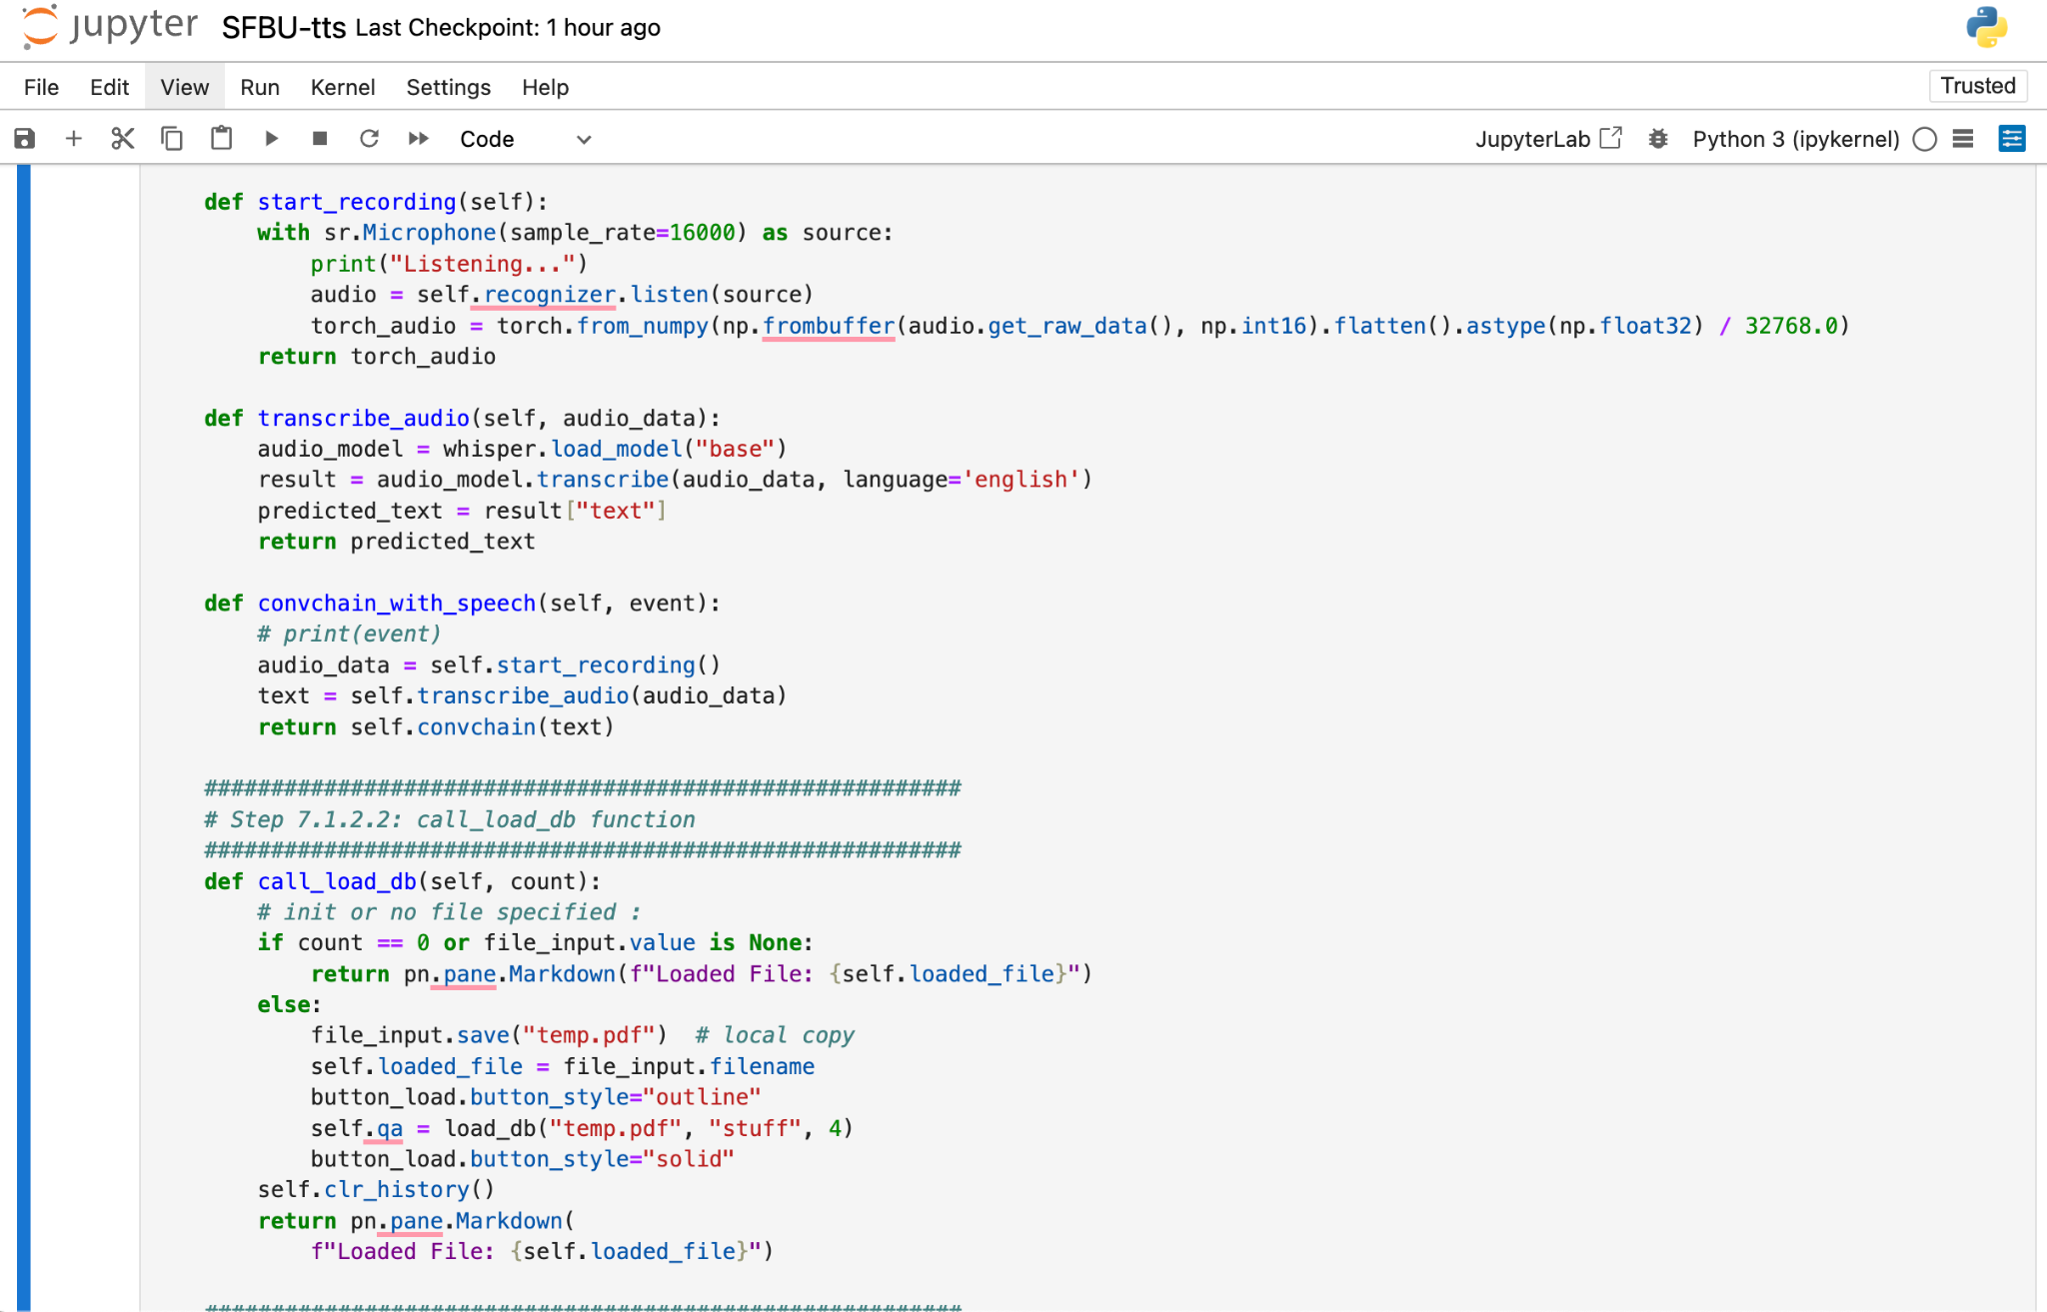

Slide 10
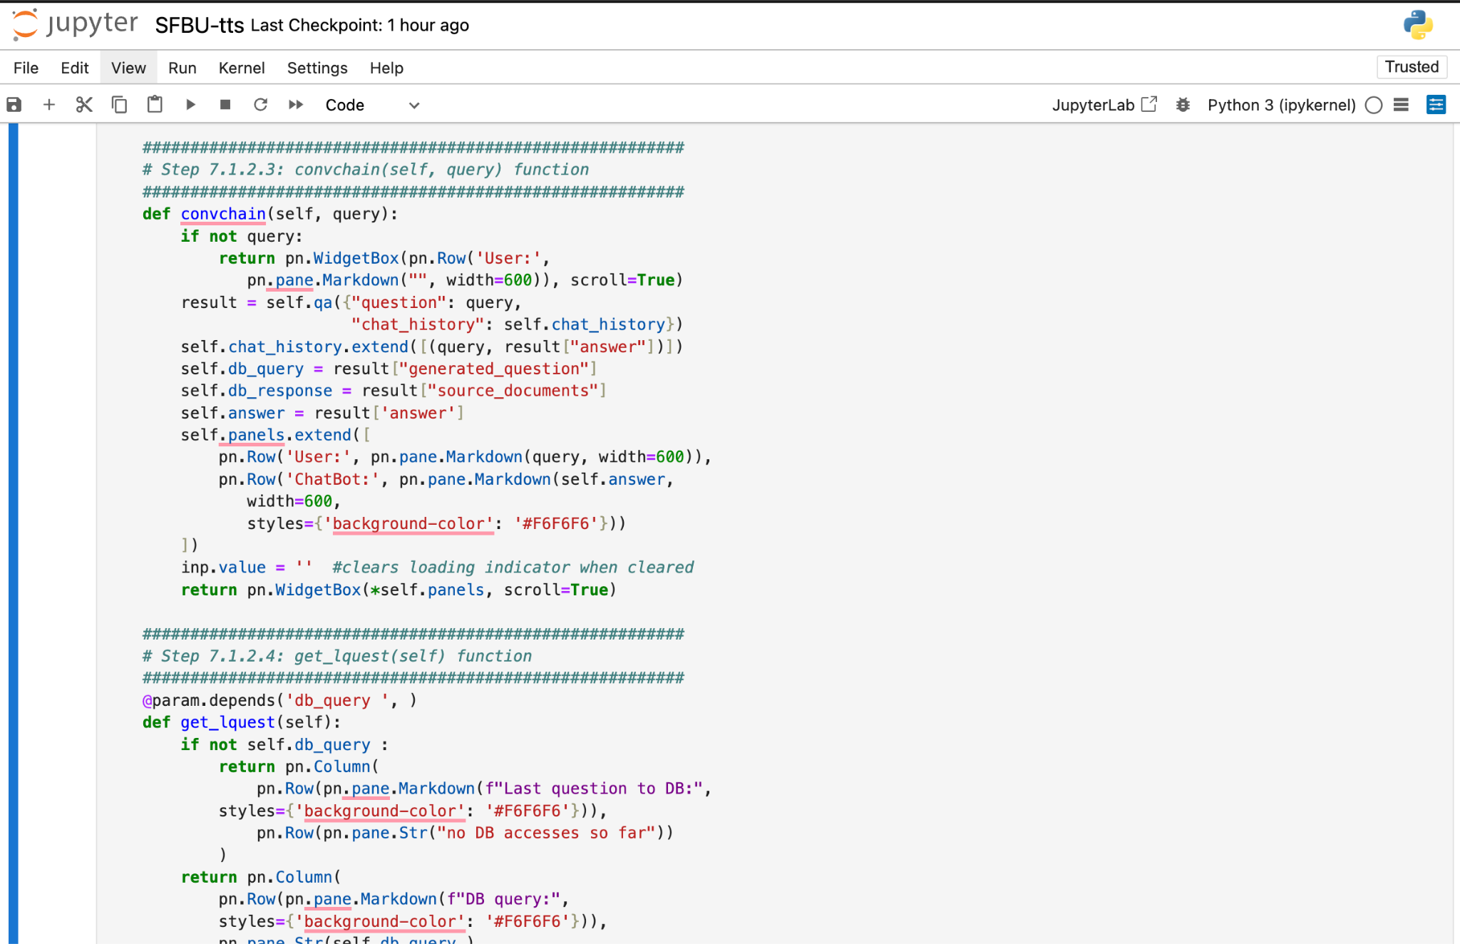
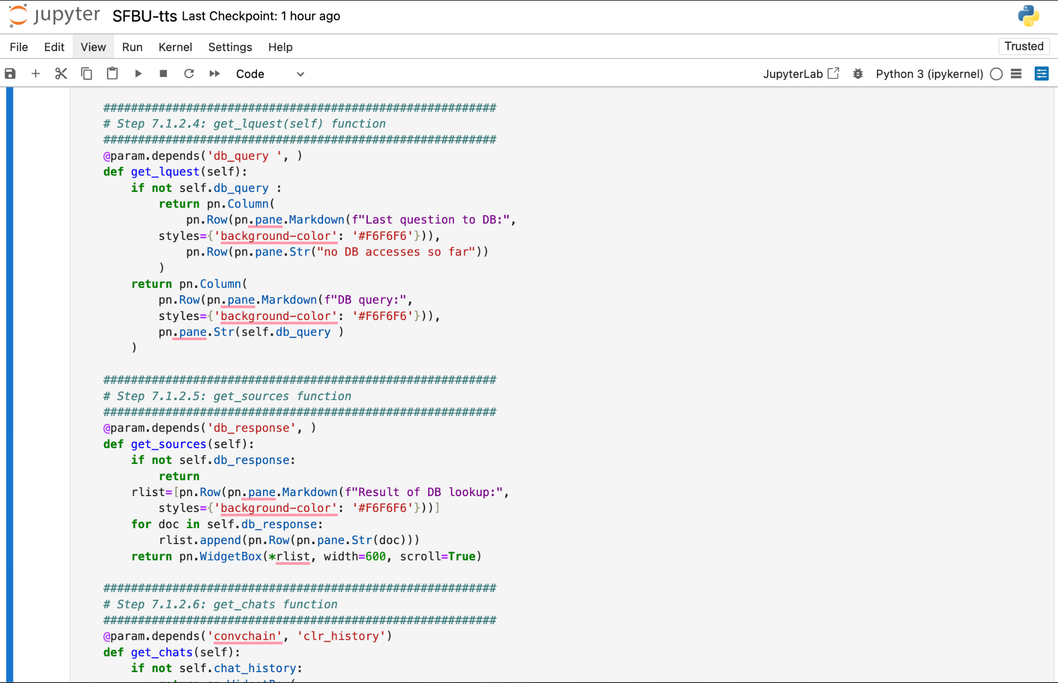

Slide 11
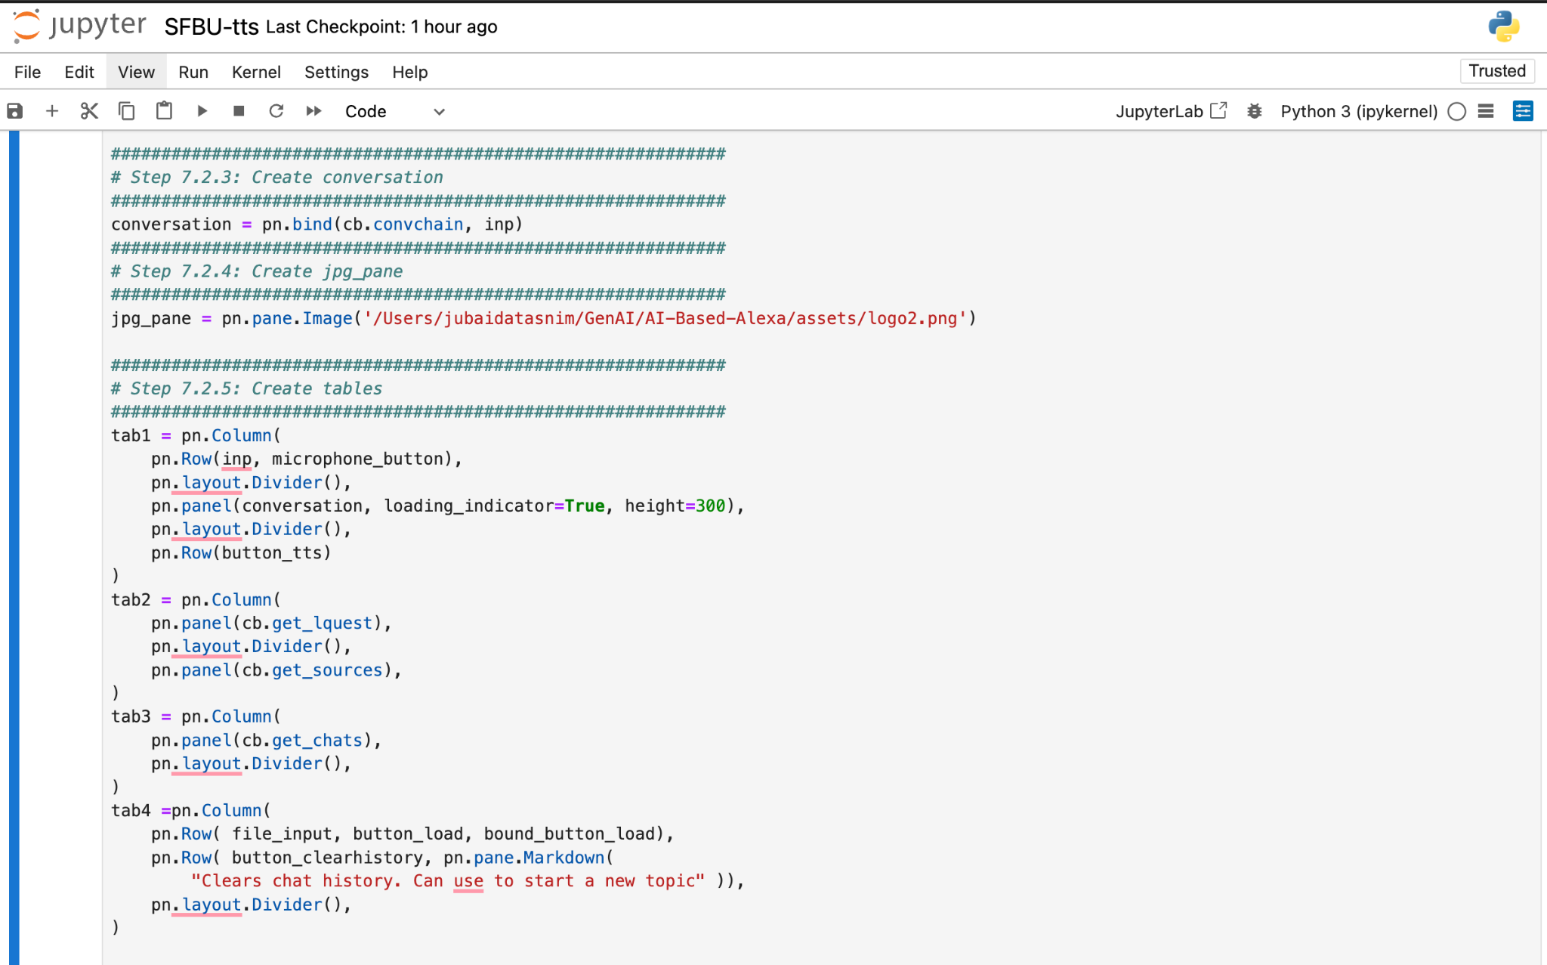

Slide 12
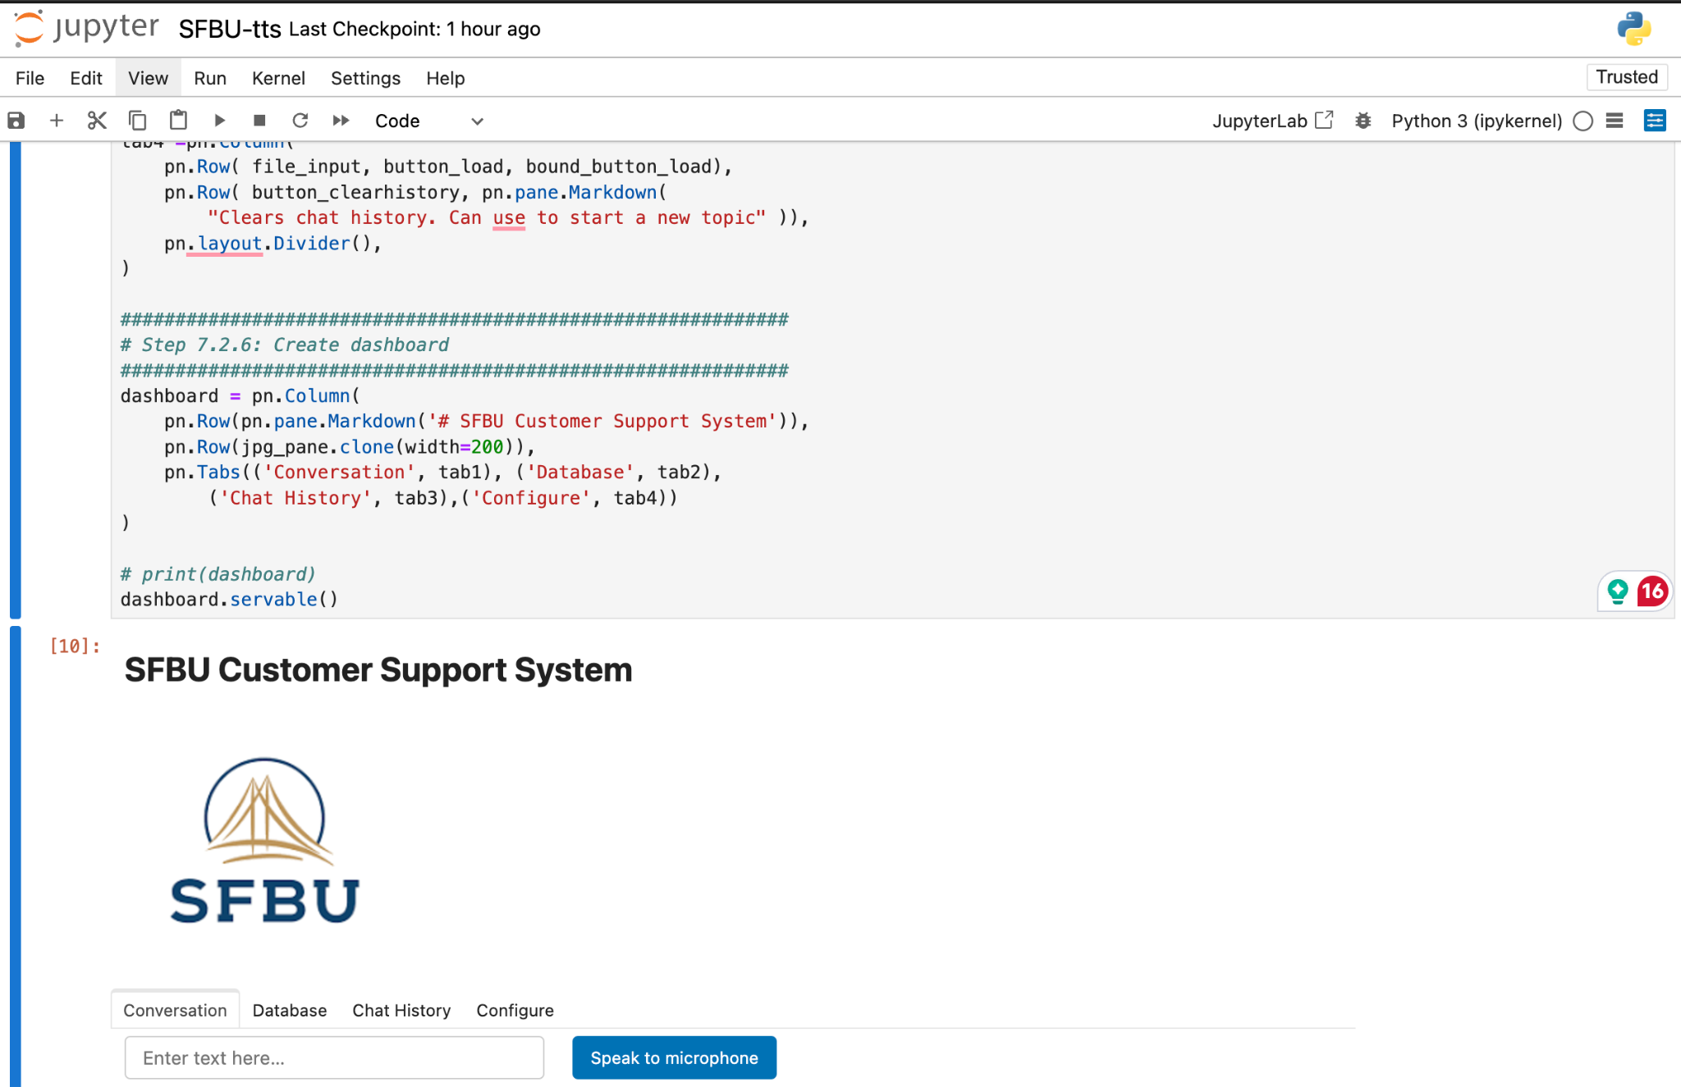

Slide 13
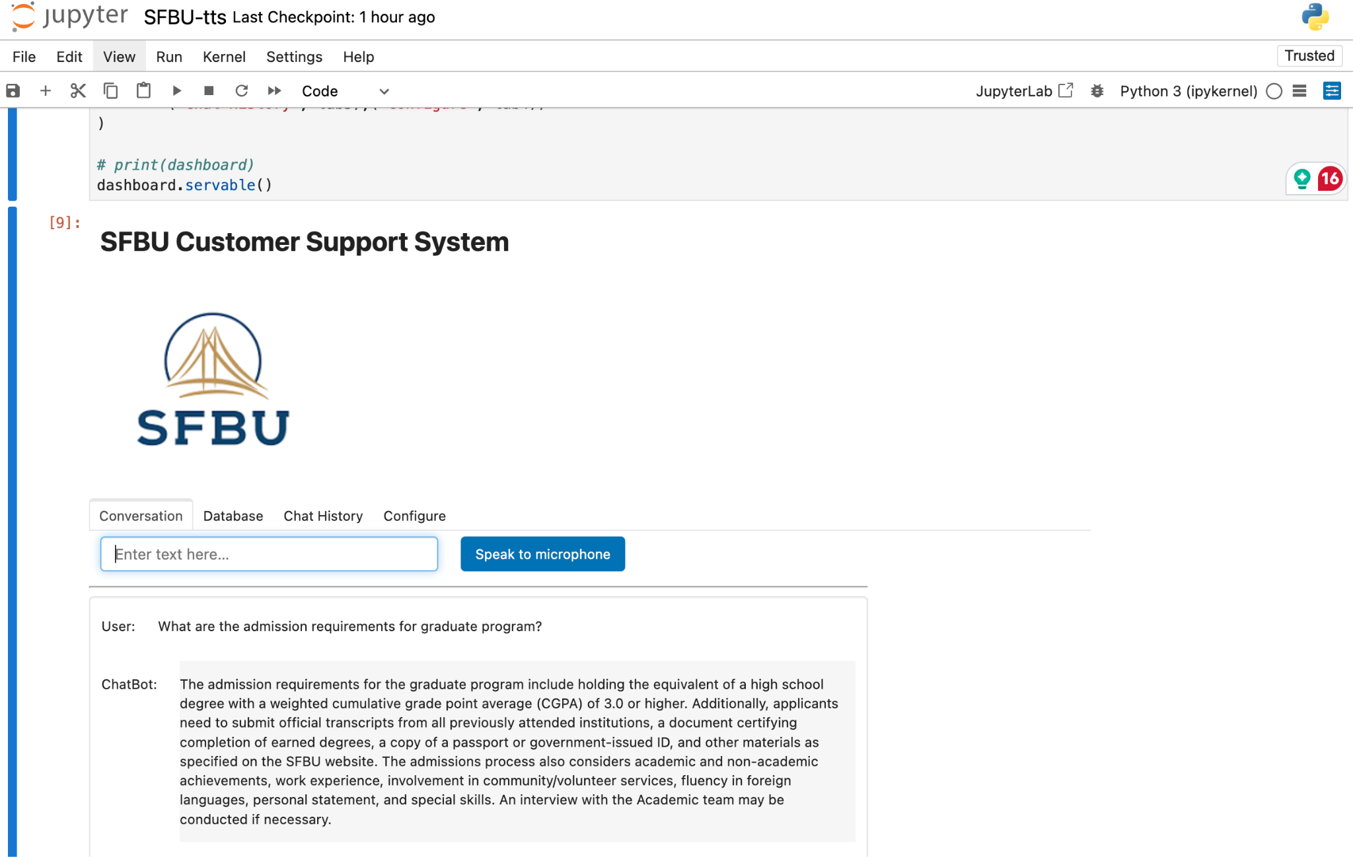

Slide 14
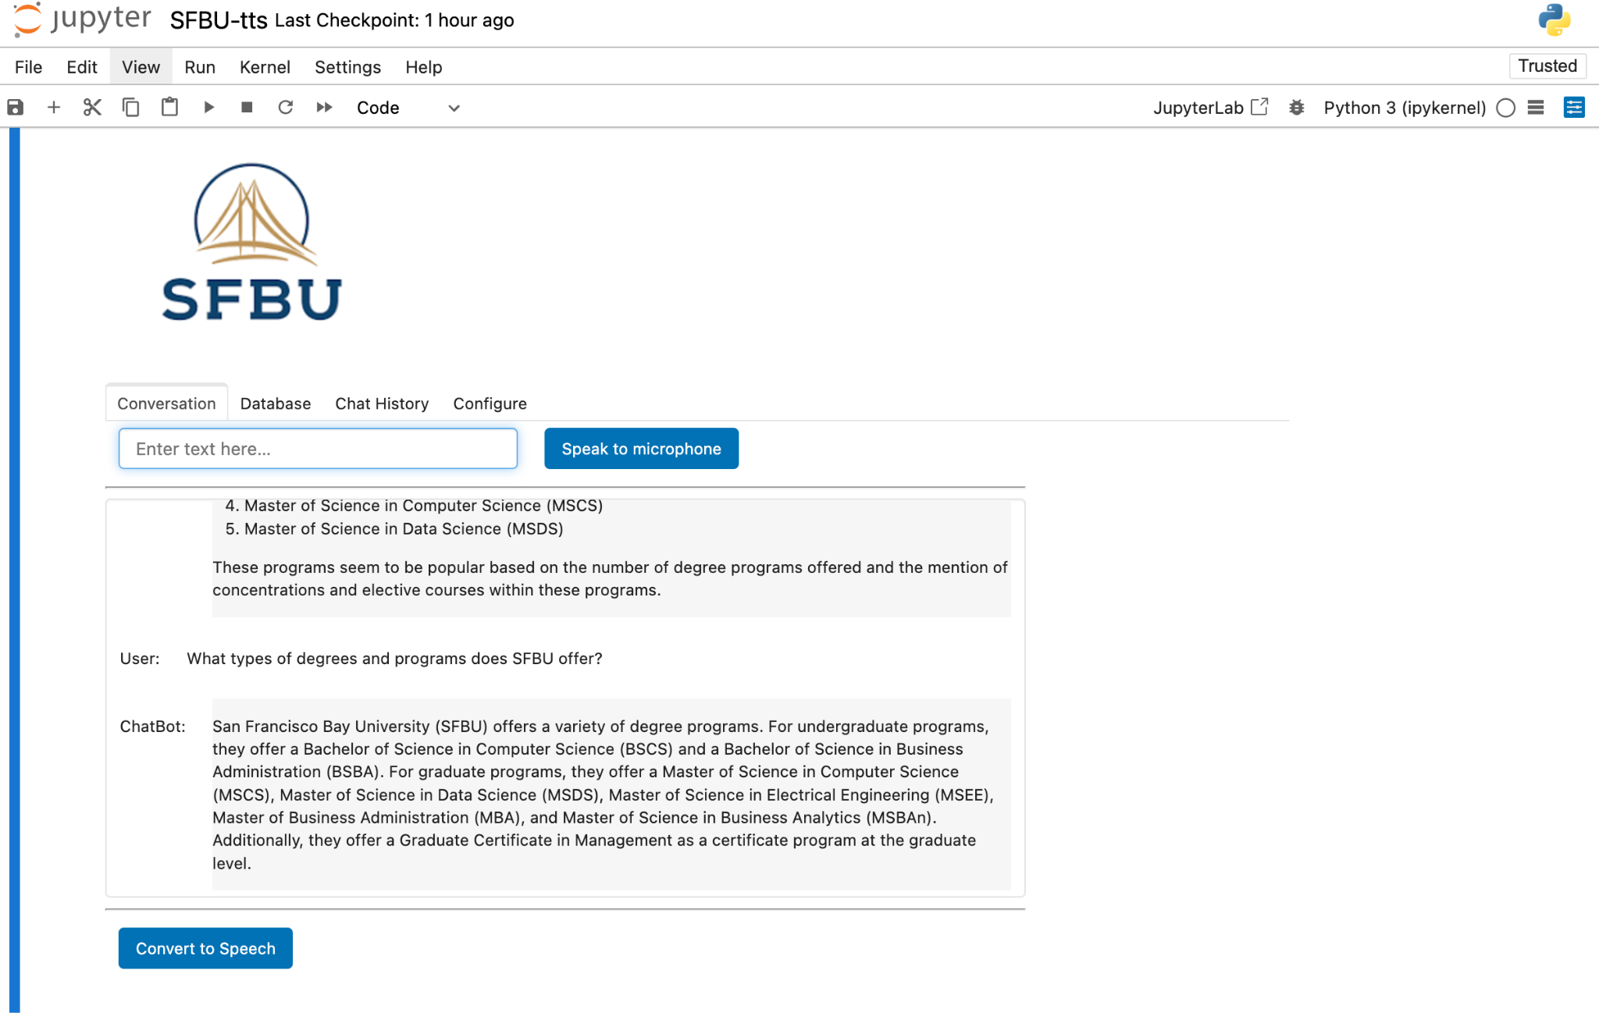

Slide 15
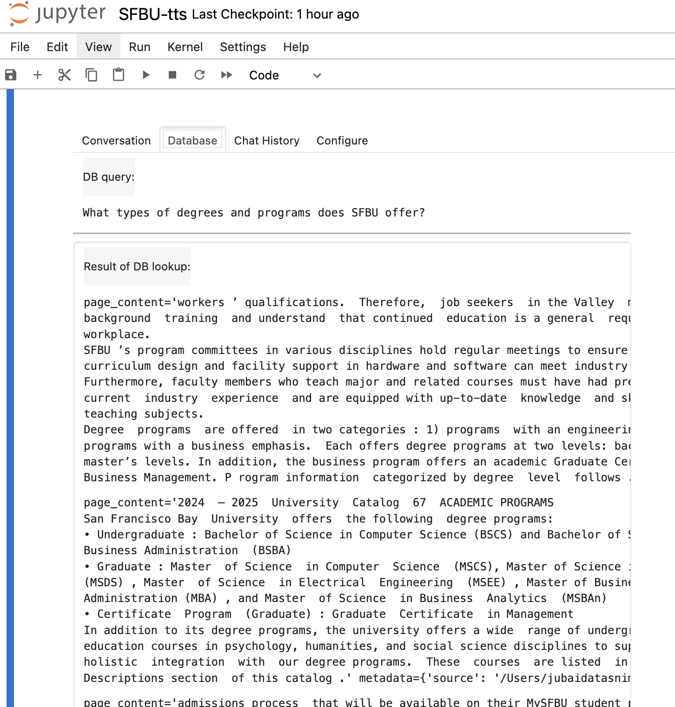
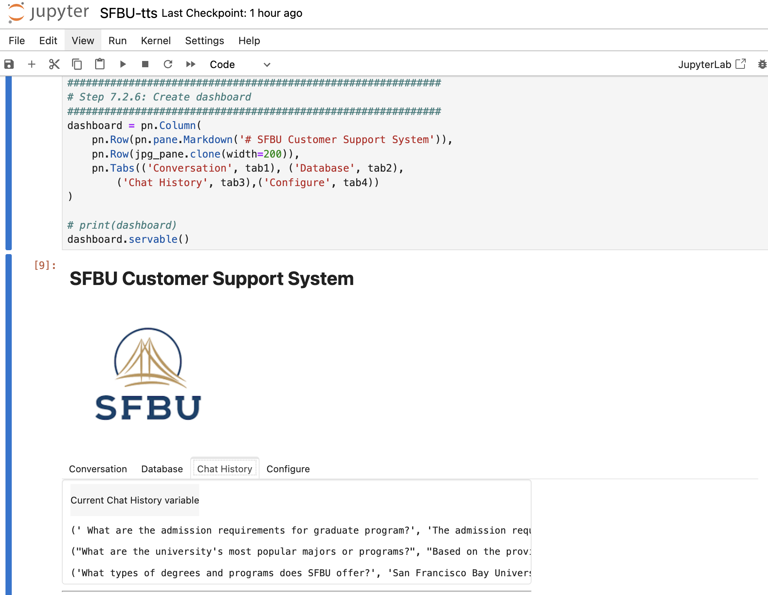

Slide 16
Enhancement Ideas
Improved Response Accuracy:
Enhance query understanding by fine-tuning the retrieval chain.
Dynamic Voice Options:
Integrate support for multiple voices and languages.
Scalability:
Optimize for handling large-scale documents.
Interactive GUI:
Create a web-based interface for broader accessibility.

Slide 17
Conclusion
Summary:
Built a robust customer support system integrating speech-to-text, document retrieval, and text-to-speech.
Demonstrated the effectiveness of AI in real-time interaction.
Future Steps:
Implement enhancements.
Deploy the system for practical use at SFBU.

